Slide 1
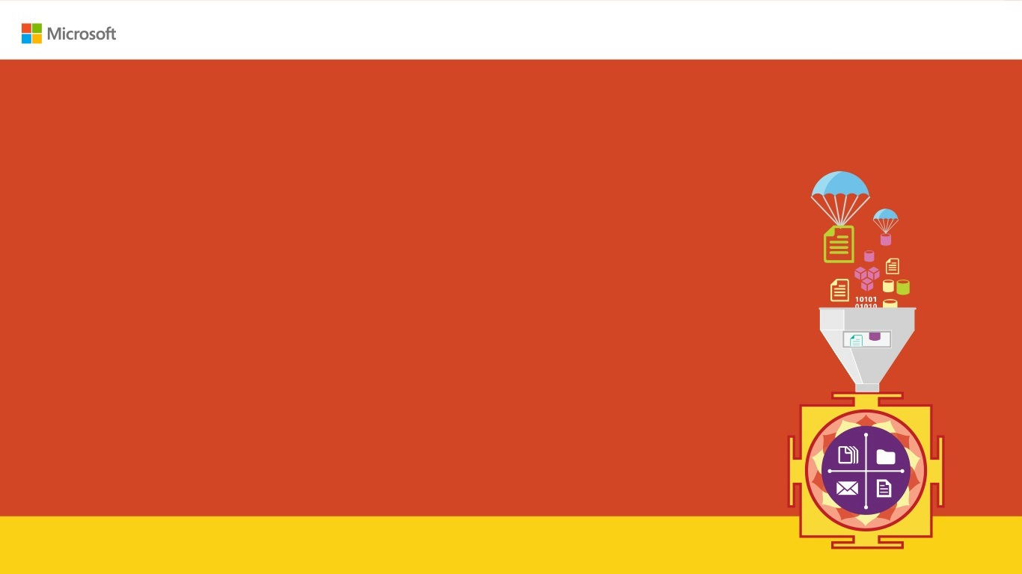
Dev-Test on Microsoft Azure – Quickly get “ready to test”
Abdul Rasheed Feroz Khan
@TechFero
feroz@cwtechnologies.in

Slide 2

Enter Text
Agenda:
What is Dev-Test?
Benefits of Azure Dev-Test.
Demo – Creating a Dev-Test environment.
Demo – Creating a Claimable Virtual Machine.
Documentation

Slide 3
Enter Text
What is Dev-Test?

Slide 4
Enter Text
Benefits of Azure Dev-Test:
Auto-Service by Azure.
Test Environment.
Availability.
Integration.
Notes:
Artifacts -

Slide 5
Enter Text
Creating a Dev-Test Environment

Slide 6
Creating a Claimable Virtual Machine

Slide 7
Enter Text
Documentations for Hands-On:
Slide - http://bit.do/devtestslides
Creating a Dev-Test Environment – http://bit.do/avdevtest
Creating a Claimable Virtual Machine - http://bit.do/avdevtestvm

Slide 8

Enter Text
Thanks for Joining!!
Abdul Rasheed Feroz Khan
Feel free to reach me for any queries:
@TechFero | @CloudWorldTech
feroz@cwtechnologies.in

